Slide 1
2022 Annual Membership Meeting
Impact Report
DC Credit Union:
Expanding Our
Digital & Operational Synergies

Slide 2
68th Annual Membership Meeting Agenda Thursday, June 30, 2022 - 12:00 p.m. - Zoom Virtual Platform

Slide 3
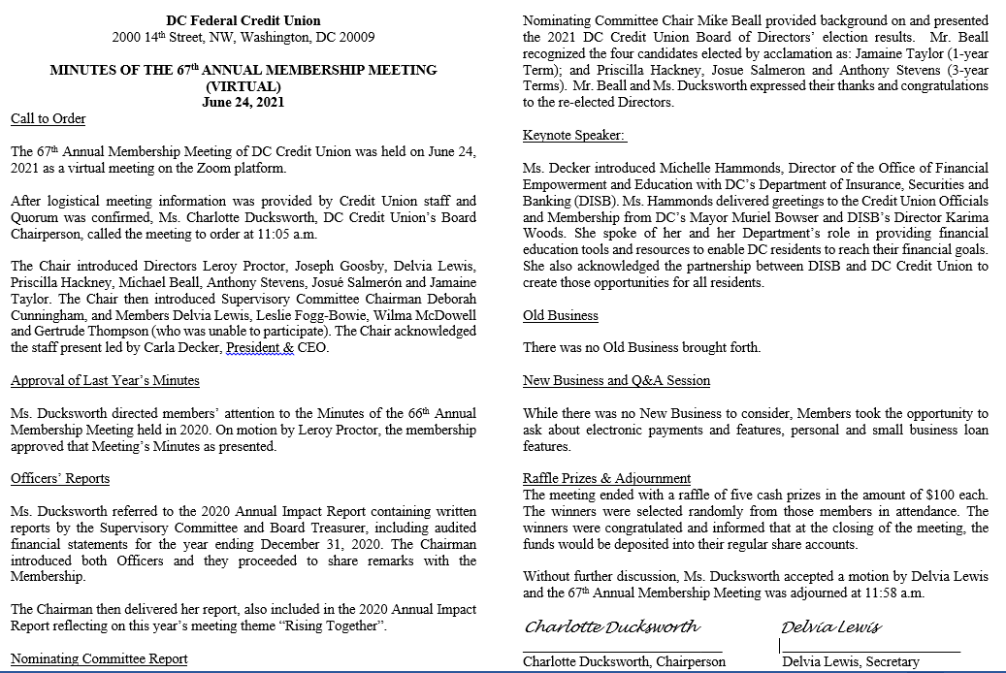
2021 Annual Membership Meeting Minutes

Slide 4
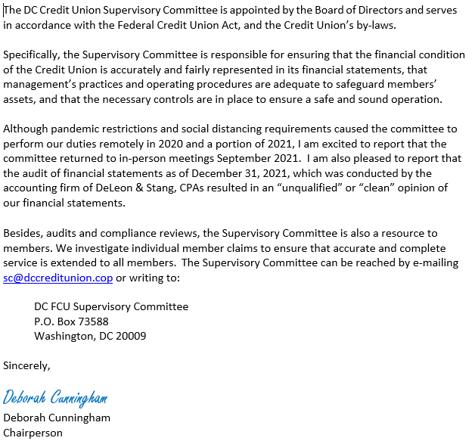
Supervisory Committee Report

Slide 5
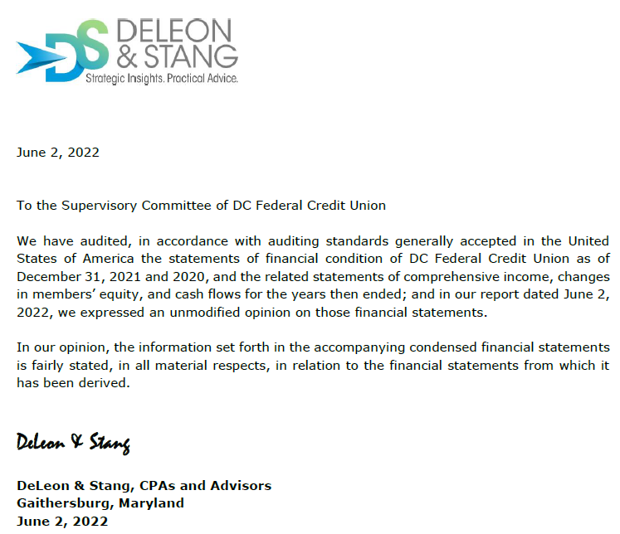
Independent Auditor’s Report

Slide 6
Treasurer’s Report

Slide 7
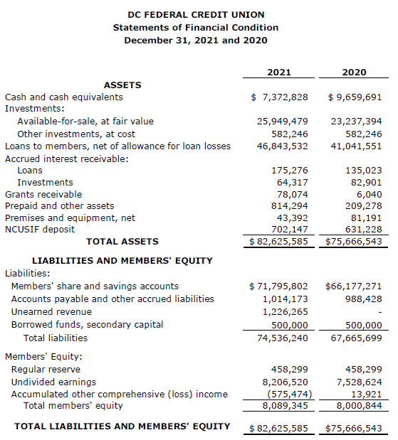
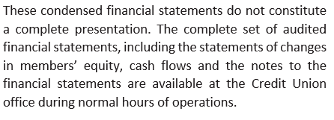
Statements of Financial Condition

Slide 8
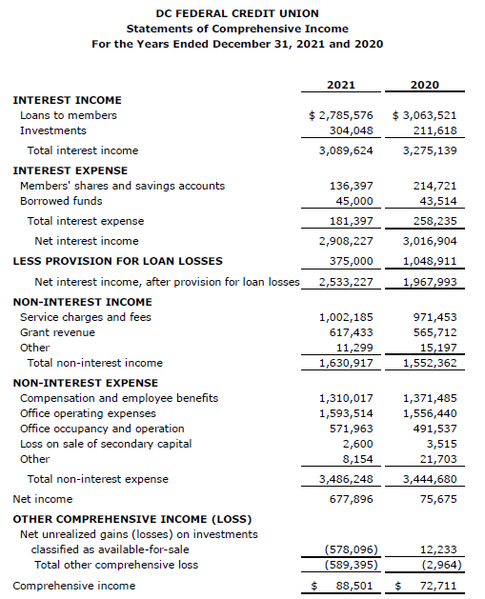
Statements of Comprehensive Income

Slide 9
Chairperson’s Report

Slide 10
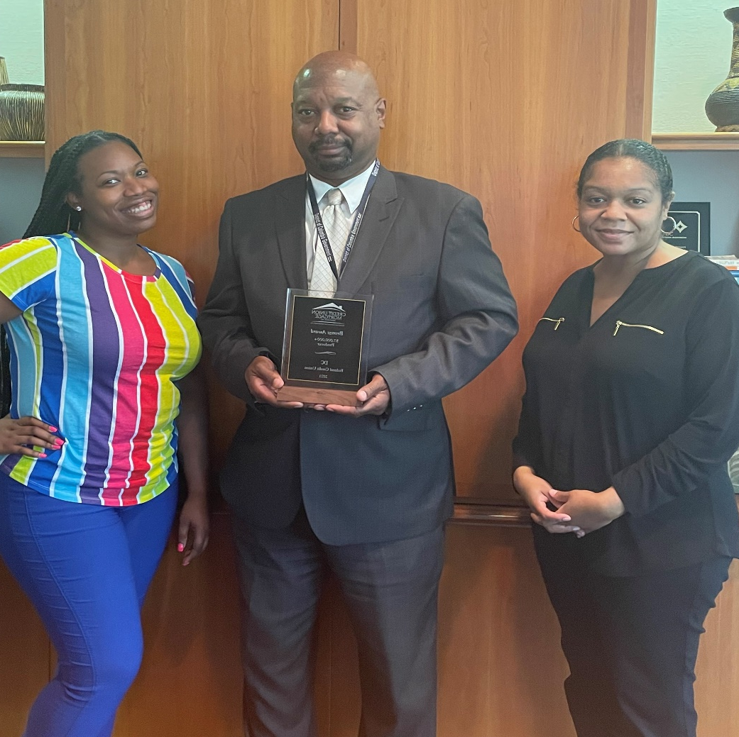
DC Credit Union Lending Impact
We are extremely proud to announce that the Credit Union Mortgage Association (CUMA) has granted DC Credit Union the 2021 Bronze Award. This was to recognize that the credit union closed over $7 million in mortgage loans in a single year.

Slide 11
DC Credit Union Outreach Impact
DC Credit Union has rebuilt their partnership with Jubilee Housing through their Reentry Transitional Housing Program. We educated the residents on financial wellness.

Slide 12
DC Credit Union Outreach Impact
DC Credit Union formed a partnership with Douglas Community Land Trust. This partnership is focused on community development for small businesses and securing housing.

Slide 13
DC Credit Union Outreach Impact
Article: DC Credit Union’s Decade Of Changing Young Lives
Takeaways
A collaboration between DC Credit Union and Bank on DC has provided thousands of teens and young adults with savings accounts, financial literacy, and occupational success.
The credit union’s Youth Advisory Council provides insight into what’s working well and how the program could be improved.
The initiative creates lasting relationships with young members and helps the credit union live its mission as a Community Development Financial Institution (CDFI).

Slide 14
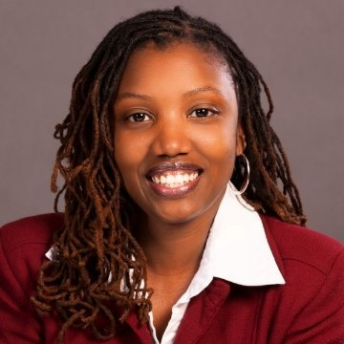
Keynote Speaker: Sybongile Cook, Director of Business Development and Strategy
Sybongile Cook is the Director of Business Development and Strategy in the Office of the Deputy Mayor for Planning & Economic Development (DMPED). Since 2009, Sybongile has held multiple roles within the Executive Office. She has led major initiatives like the Bank on DC program banking over 11,000 residents, conducting 900 financial education classes, and training 500 social service providers and launched the Neighborhood Prosperity Fund (NPF) to award catalytic projects in underinvested communities. The first NPF grant resulted in Ward 8’s first community grocer, Good Food Market. In the last 24 months (during the height of the public health emergency COVID-19), she directed over 350 million dollars in relief to business and capital improvement grants. Prior to her current role at DMPED, she worked at the Department of Employment Services (DOES) and launched their Office of Talent & Clients Services.
Originally from Houston, Texas, she has called the District of Columbia home. She is a licensed life & health insurance broker and enjoys traveling, teaching, dancing, and being the best “Auntie Bongo” to her twin nieces and nephew.

Slide 15
2022 Annual Membership Meeting
Q&A - Raffle - Reflections
Old & New Business
DC Credit Union:
Expanding Our
Digital & Operational Synergies

Slide 16
